Slide 1

Run or Walk Prediction
Data Analytics
GROUP- 132
LAVANYA SURIKAPURAM(A20392981)

Slide 2
Overview
Introduction
Data
Problems to be Solved
Data Processing
Methods and Process
Evaluations and Results
Conclusions and Future Work

Slide 3
INTRODUCTION

Slide 4
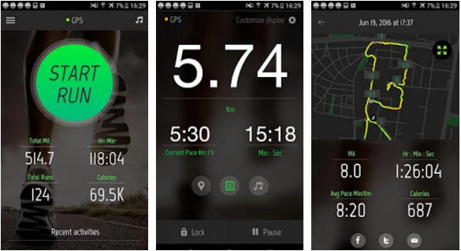
Objective

Slide 5
DATA

Slide 6
Source of the Data?
Where?
Data collected from iOS device.
How?
Based on deep neural network and sensor present in iOS device.
What are the sensors?
Many different sensory devices are used to determine the position and orientation of an object. The most common of these sensors are the gyroscope and the accelerometer.

Slide 7
DATASET
Fields:
acceleration_x
acceleration_y
acceleration_z
gyro_x
gyro_y
gyro_z
Activity
wrist
Records:
88588 sensor data samples
Data Source:
https://www.kaggle.com/vmalyi/run-or-walk

Slide 8
Problems to be Solved

Slide 9
Problems?
Problem 1
Assuming both acceleration_x between the person who is walking and the person who is running are approximately normal with equal variances, is there a difference in mean yield?
Problem 2
I was told the average Axcellaration_x for the person who is running is -0.09F. But I do not think so?
Problem 3
I was told the average Axcellaration_x for the person who is running is leass than -0.09F. But I do not think so?
Problem 4
The main problem in this project is to detect whether the person is running or walking based on deep neural network and sensor data collected from iOS device?
Problem 5
What are the influential factors for the running and walking activity?

Slide 10
What are the statistical methods be applied to solve the problems?
Problem 1
Assuming both acceleration_x between the person who is walking and the person who is running are approximately normal with equal variances, is there a difference in mean yield?
2 sampled Independent hypothesis testing
One sample Two Tailed hypothesis testing
Problem 2
I was told the average Axcellaration_x for the person who is running is -0.09F. But I do not think so?

Slide 11
Problem 3
I was told the average Axcellaration_x for the person who is running is less than -0.09F. But I do not think so?
One sample oneTailed hypothesis testing
Logistic Regression
Problem 4
The main problem in this project is to detect whether the person is running or walking based on deep neural network and sensor data collected from iOS device?

Slide 12


Slide 13
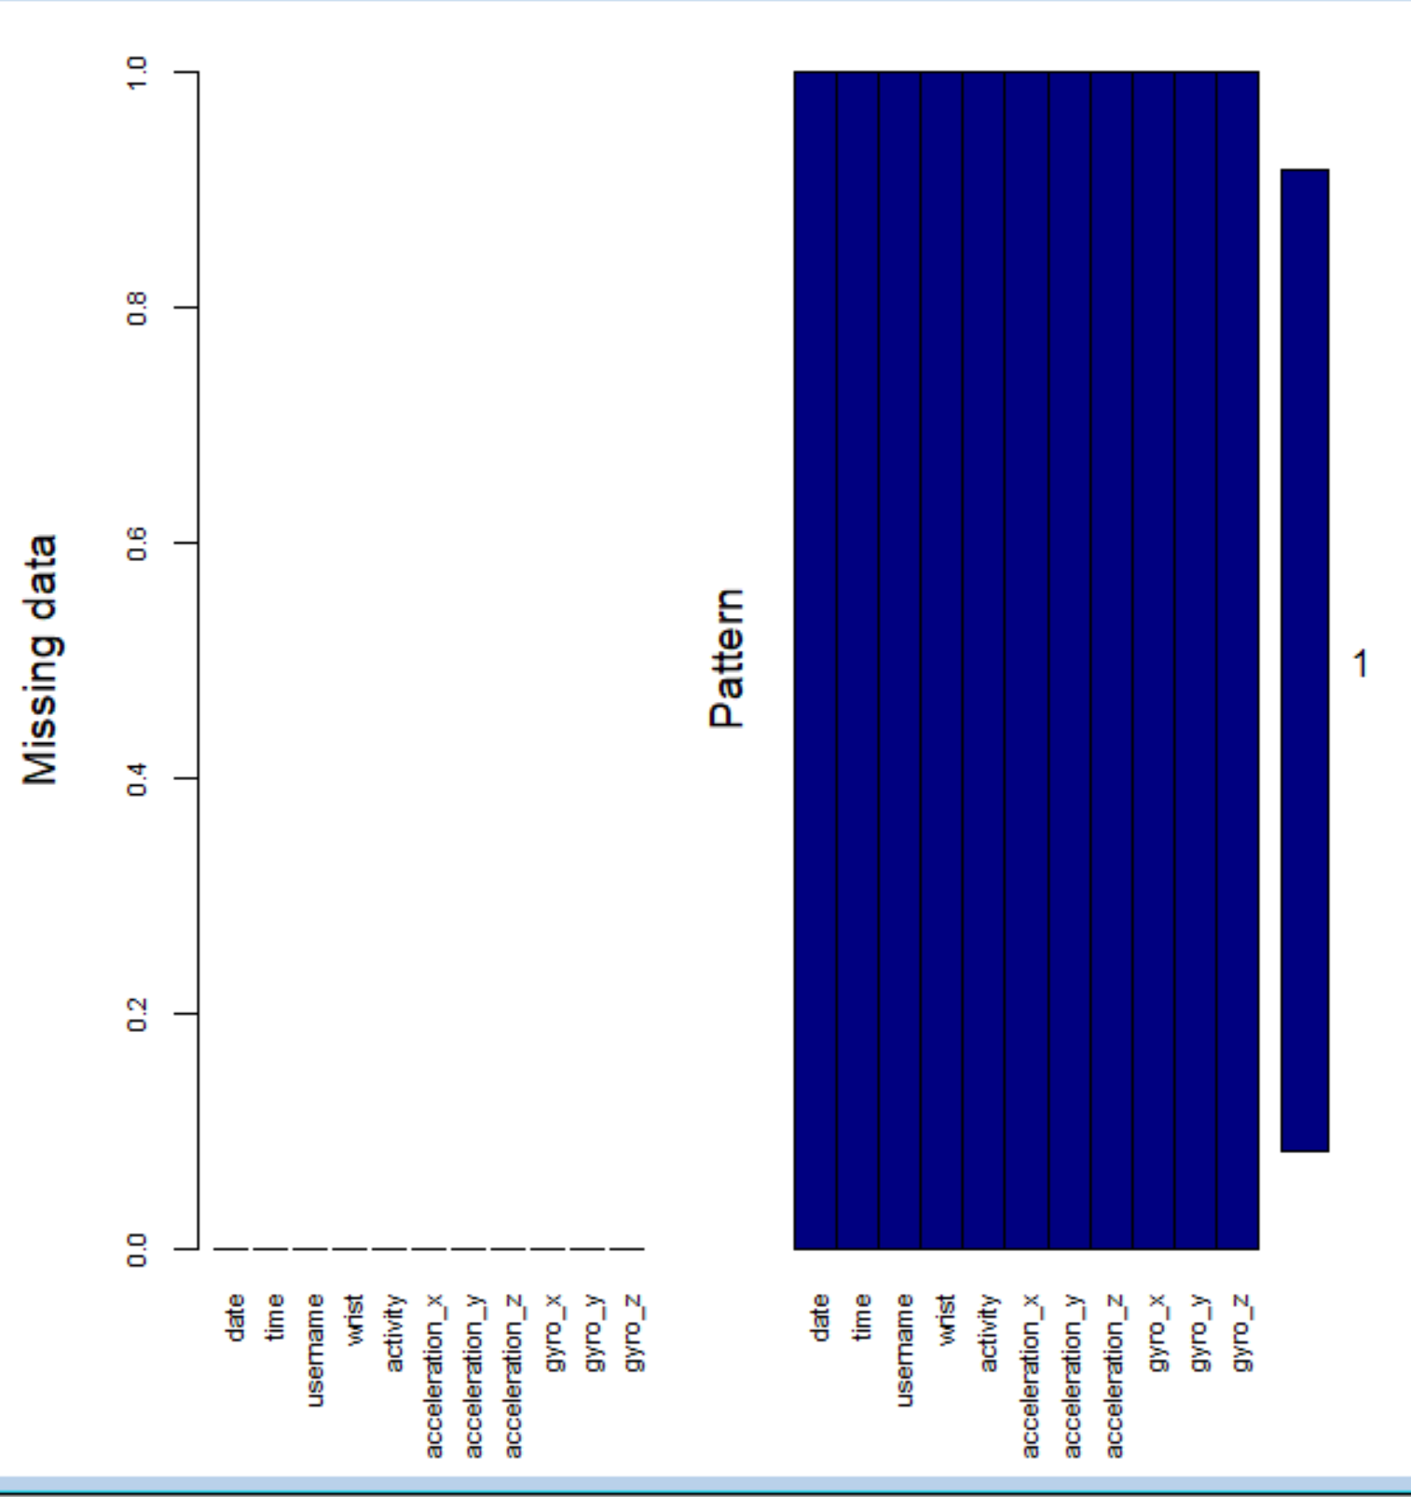
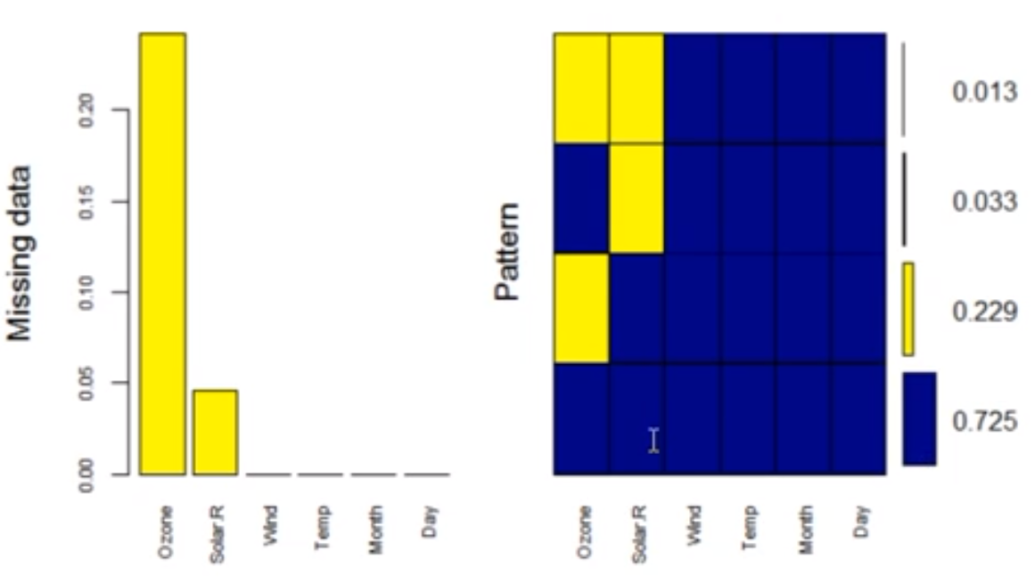
Process
How to process?
Checked for missing values in my dataset

Slide 14
DATA SPLIT
Training Data 80%
DATA
Testing Data 20%

Slide 15
Methods and Process

Slide 16
Evaluation Methods
Hypothesis Testing
Logistic Regression
Decision Trees
Random Forest
k-Nearest Neighbor Predictions

Slide 17
Hypothesis Testing
2 sampled Independent hypothesis testing
One sample Two Tailed hypothesis testing
One sample oneTailed hypothesis testing

Slide 18
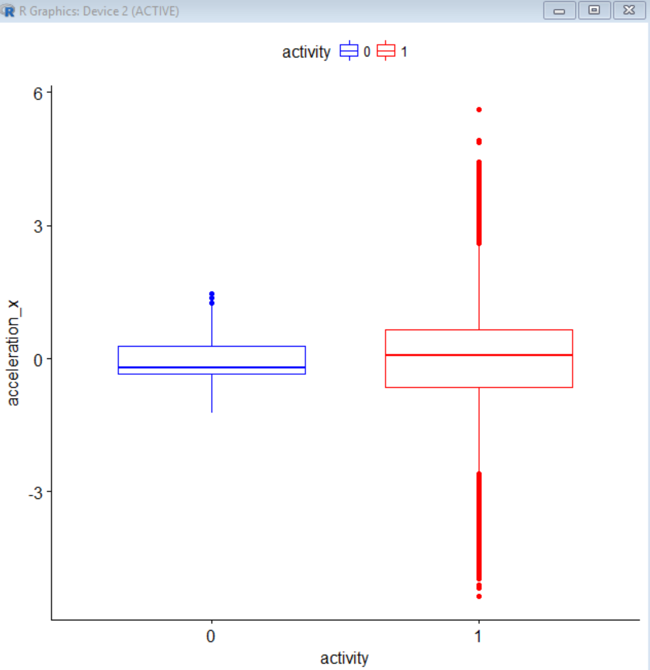
2 sampled Independent hypothesis testing
Assuming both acceleration_x between the person who is walking and the person who is running are approximately normal with equal variances, is there a difference in mean yield?

Slide 19

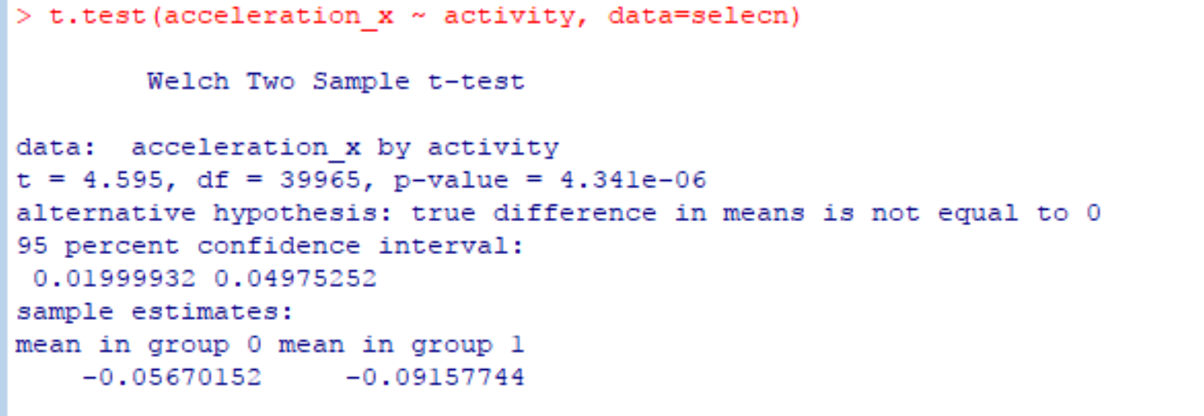
Result
Hence our Assumption was right that both the means are not same

Slide 20
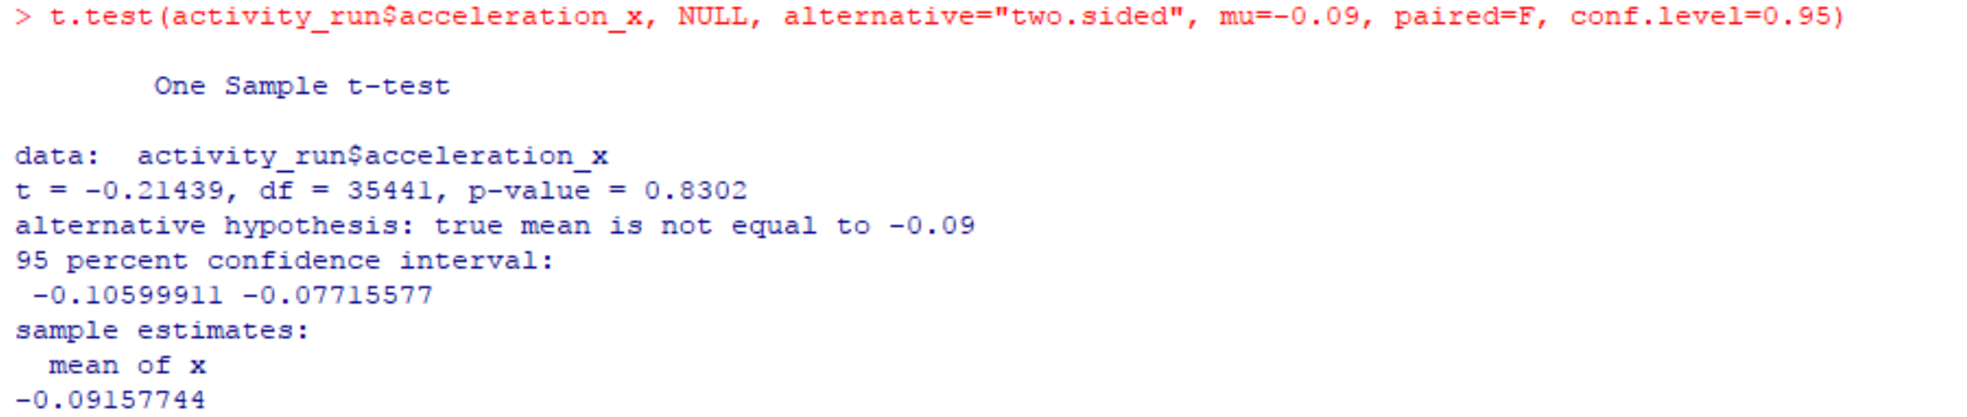

One sample Two Tailed hypothesis testing
I was told the average Axcellaration_x for the person who is running is -0.09F. But I do not think so?
Hence our Assumption was right that the average of Axcellaration_x is not equal to -0.09F

Slide 21
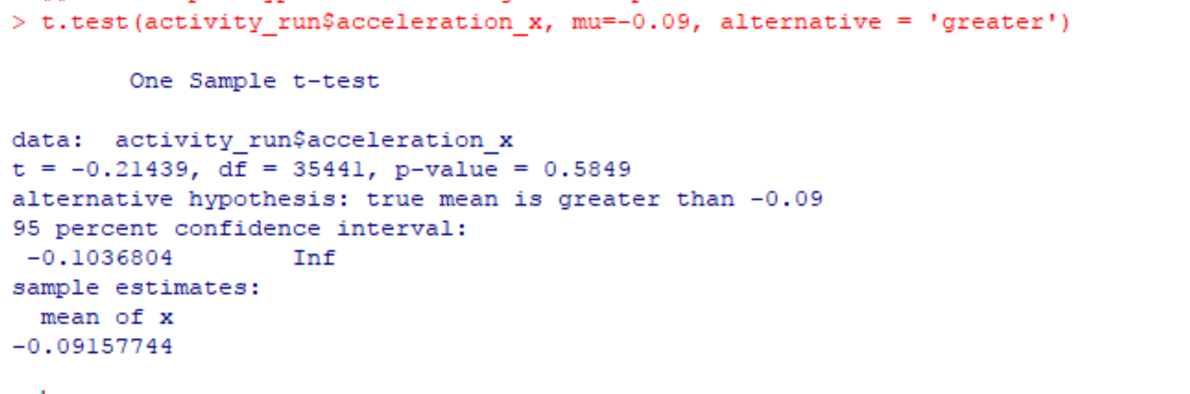

One sample one Tailed hypothesis testing
I was told the average Axcellaration_x for the person who is running is less than -0.09F. But I do not think so?
Hence our Assumption was right that the average of Axcellaration_x is not less than -0.09F

Slide 22
Logistic Regression
Backward Elimination
Step wise backward selections
step wise Forward

Slide 23

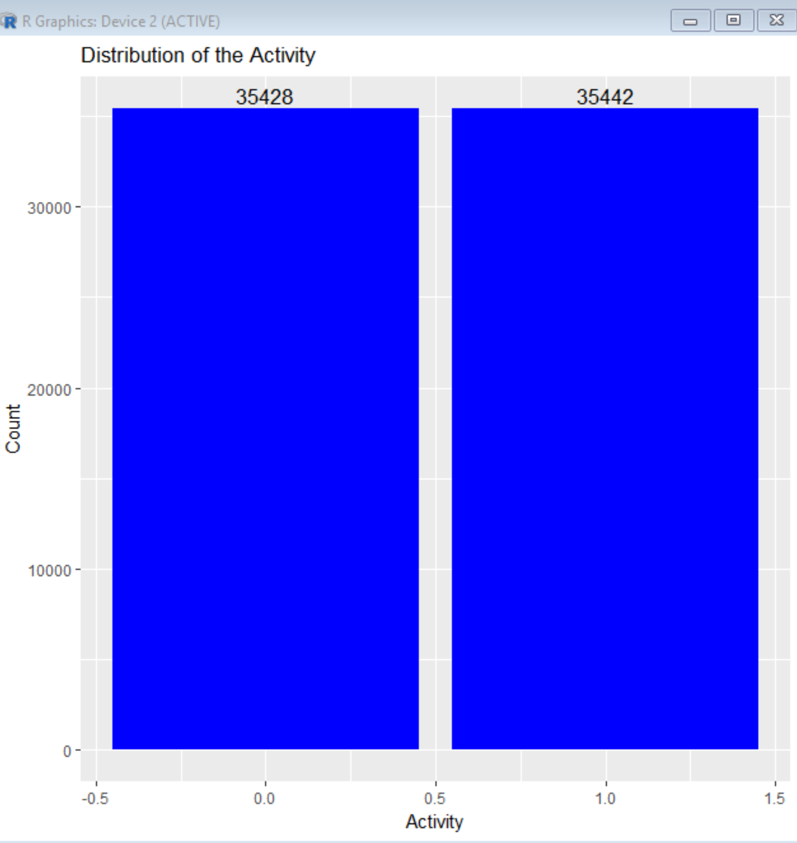

Distribution of activity

Slide 24
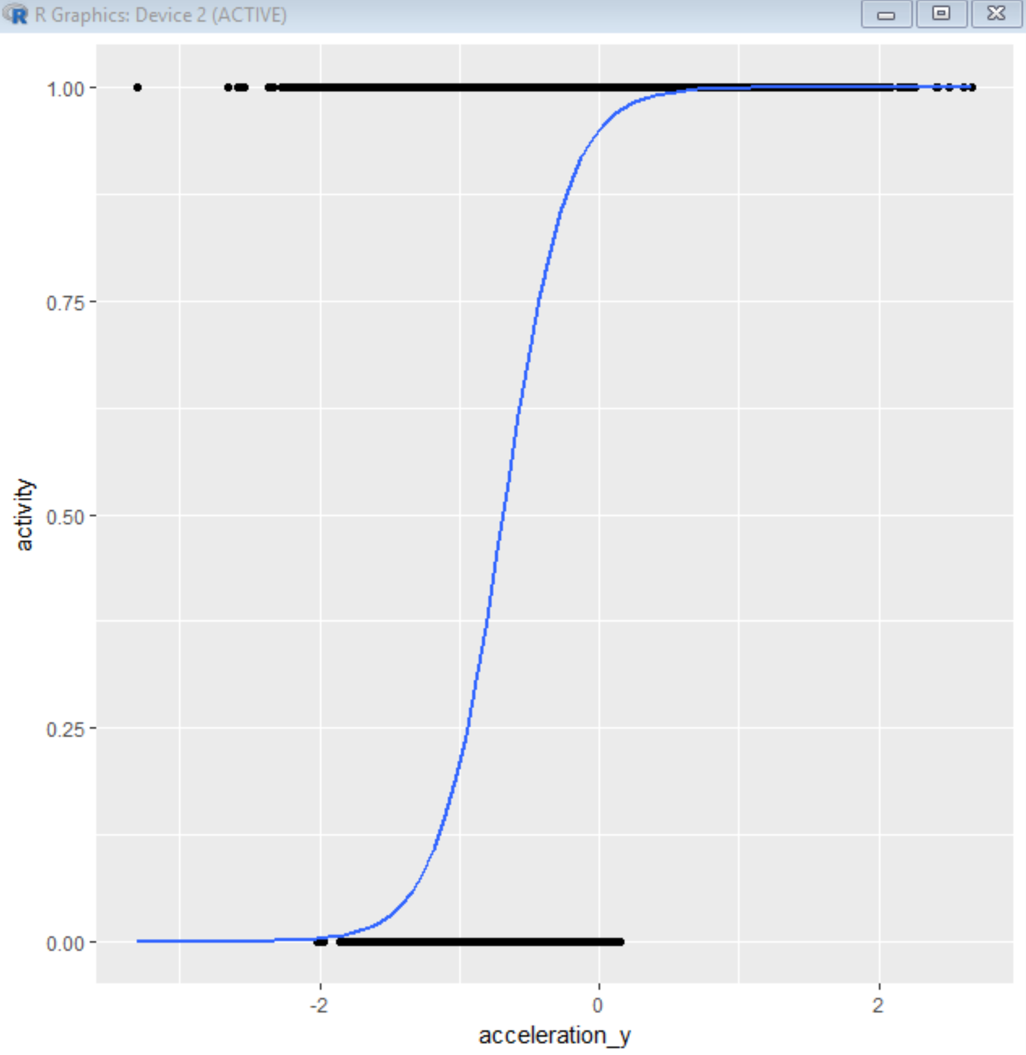
Logistic Regression Curve
This curve confirms us that the data is suitable in order to perform logistic regression

Slide 25
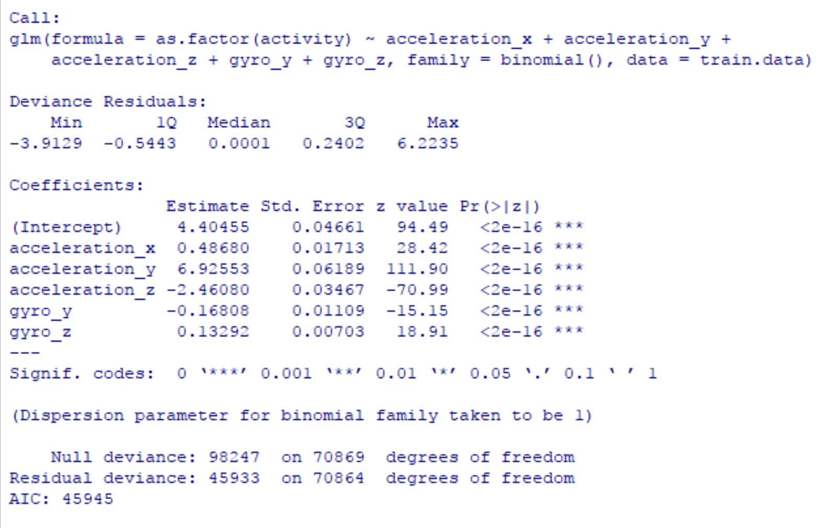


Backward Elimination
Starts with the full model and eliminates one variable at the time until a reasonable candidate regression model is found. It typically uses a criterion based on the goodness-of-fit F-test. The metric could be p-value, AIC, BIC.
Fit Model

Slide 26
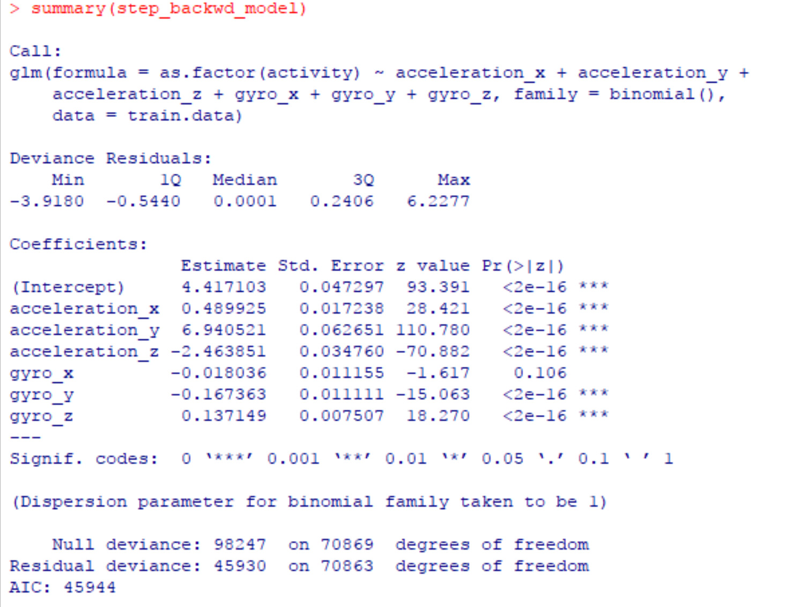

STEPWISE BACKWARD REGRESSION
Starts with all of the predictors in the model. The variable that is least significant--that is, the one with the largest P value--is removed and the model is refitted. Each subsequent step removes the least significant variable in the model until all remaining variables have individual P values smaller than some value, such as 0.05

Slide 27
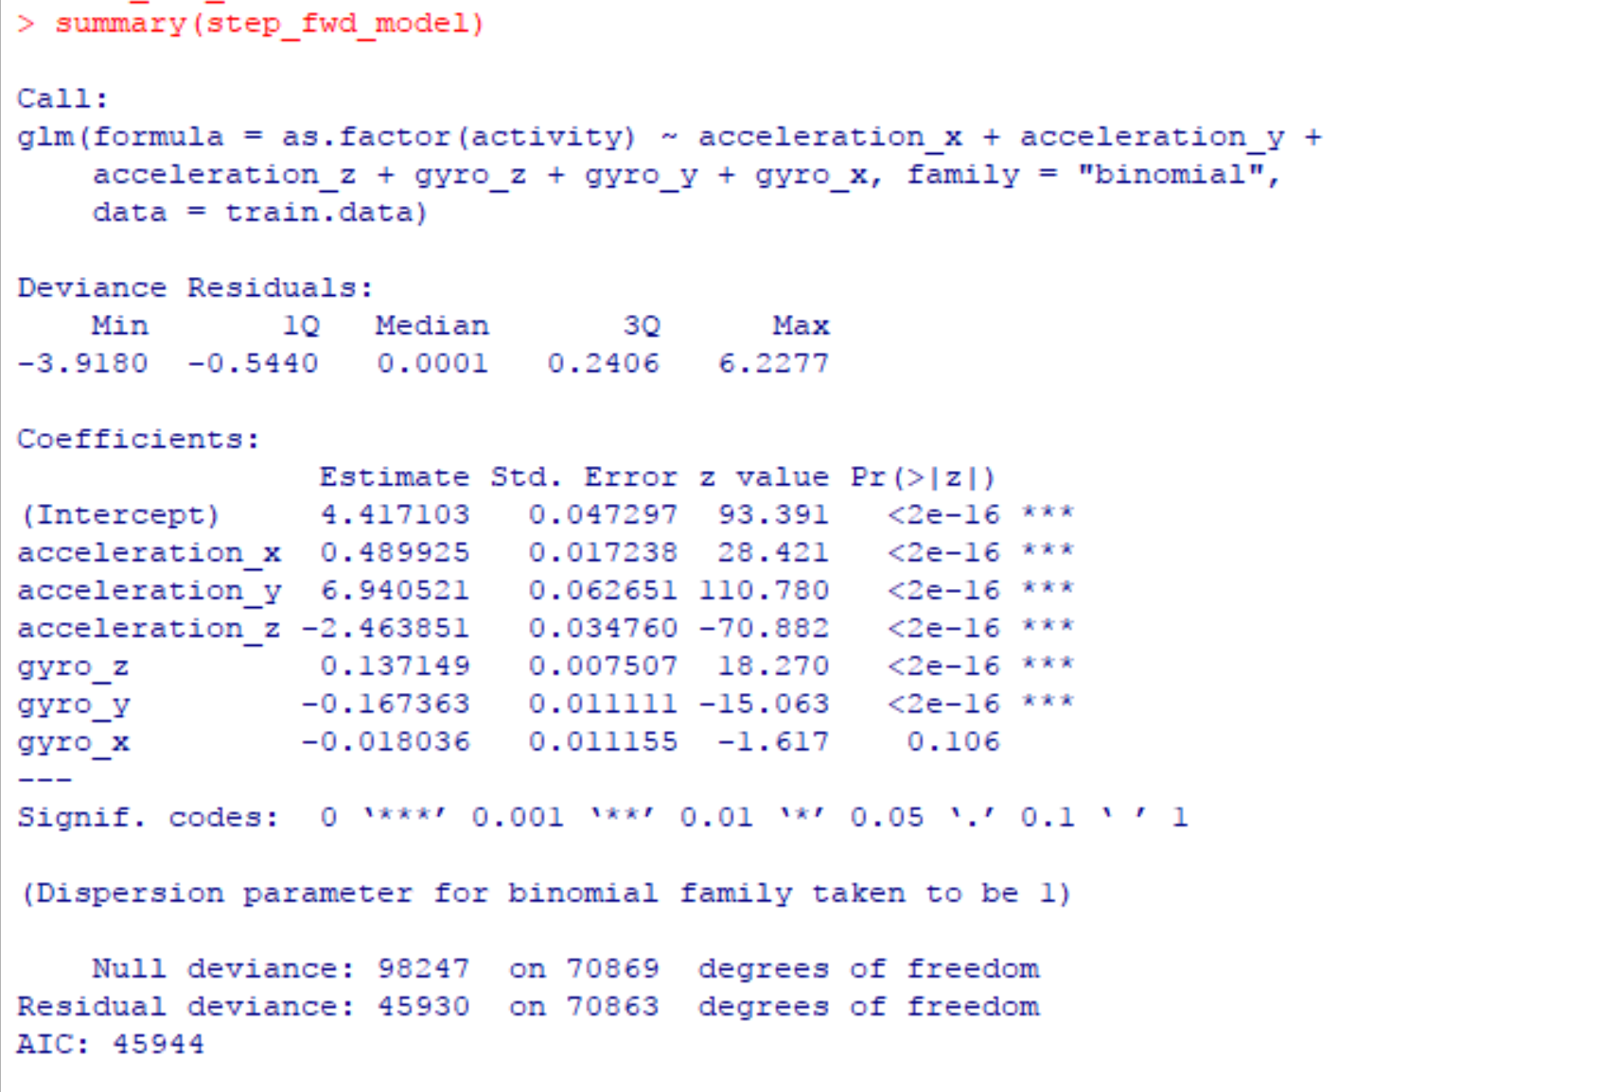

STEPWISE FOWARD REGRESSION
Starts with an empty model. The variable that has the smallest P value when it is the only predictor in the regression equation is placed in the model. Each subsequent step adds the variable that has the smallest P value in the presence of the predictors already in the equation. Variables are added one-at-a-time as long as their P values are small enough, typically less than 0.05

Slide 28
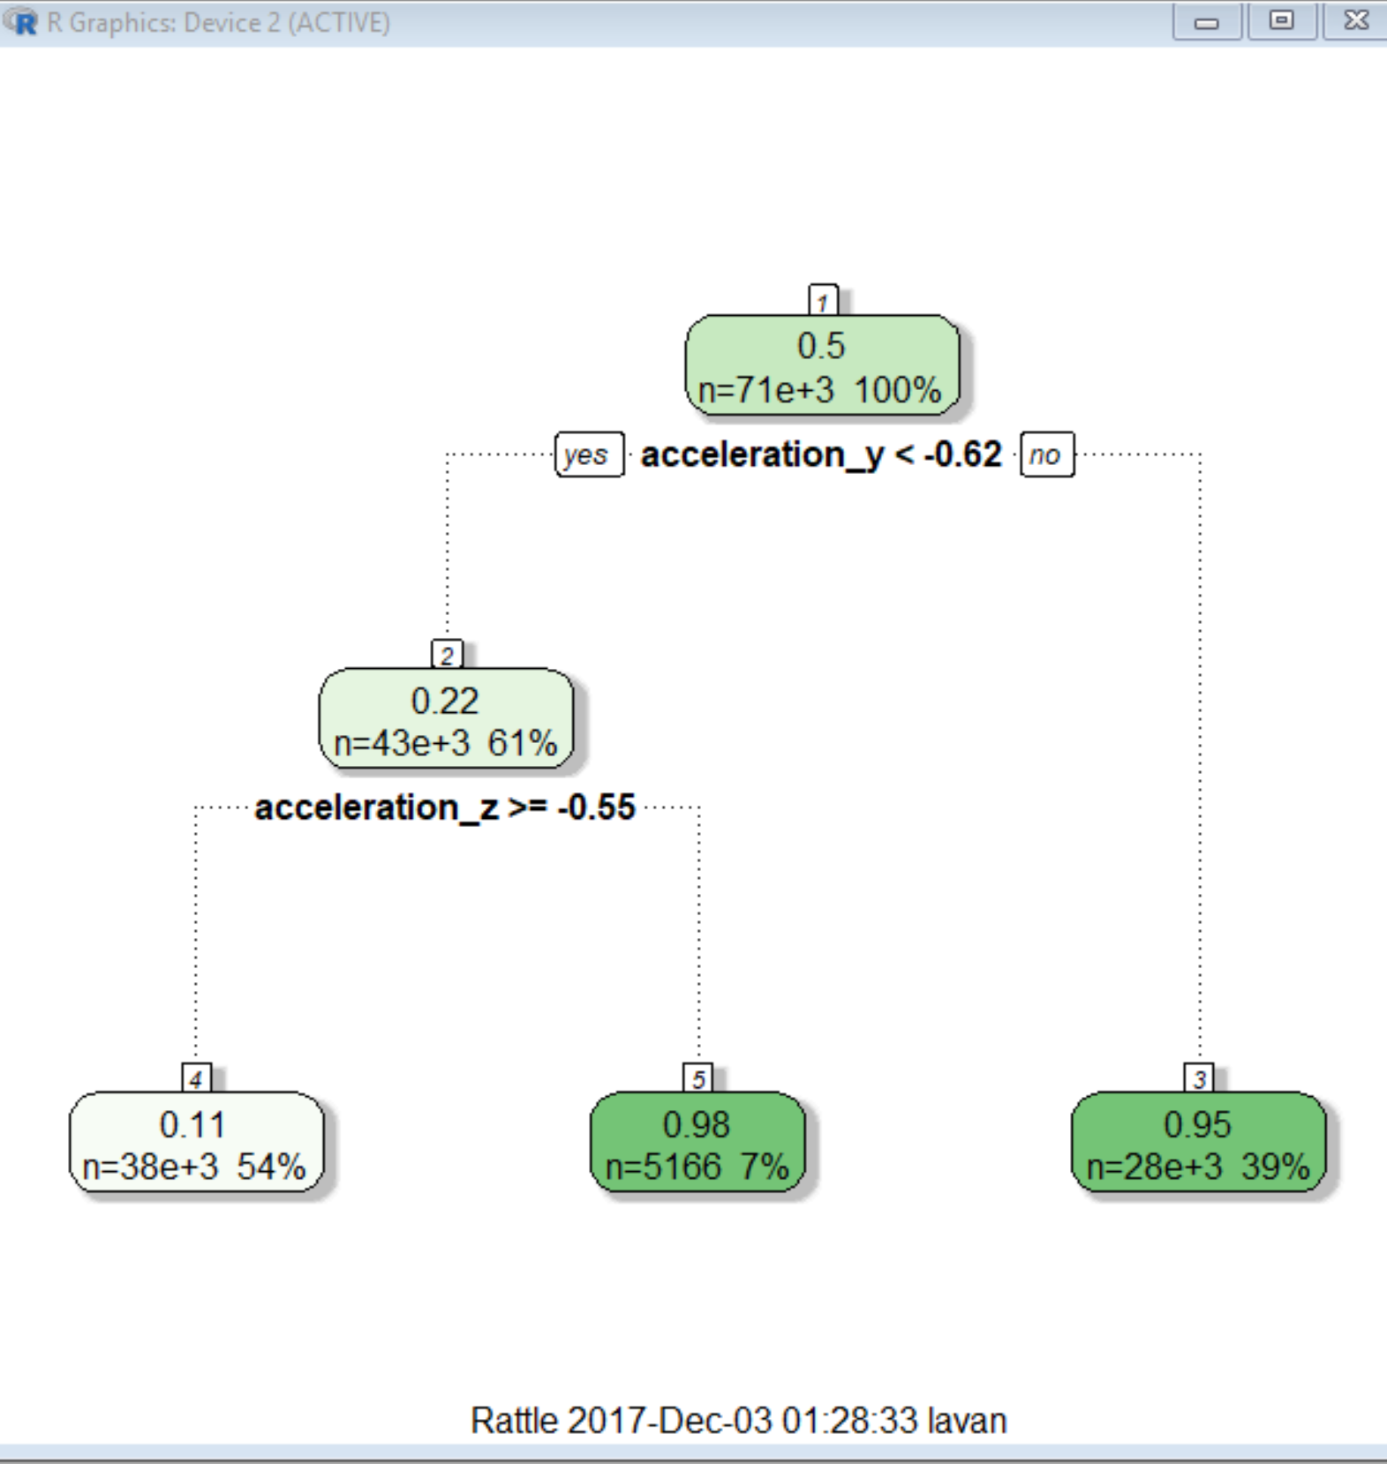

Decision Trees
A decision tree is a graph that uses a branching method to illustrate every possible outcome of a decision.

Slide 29
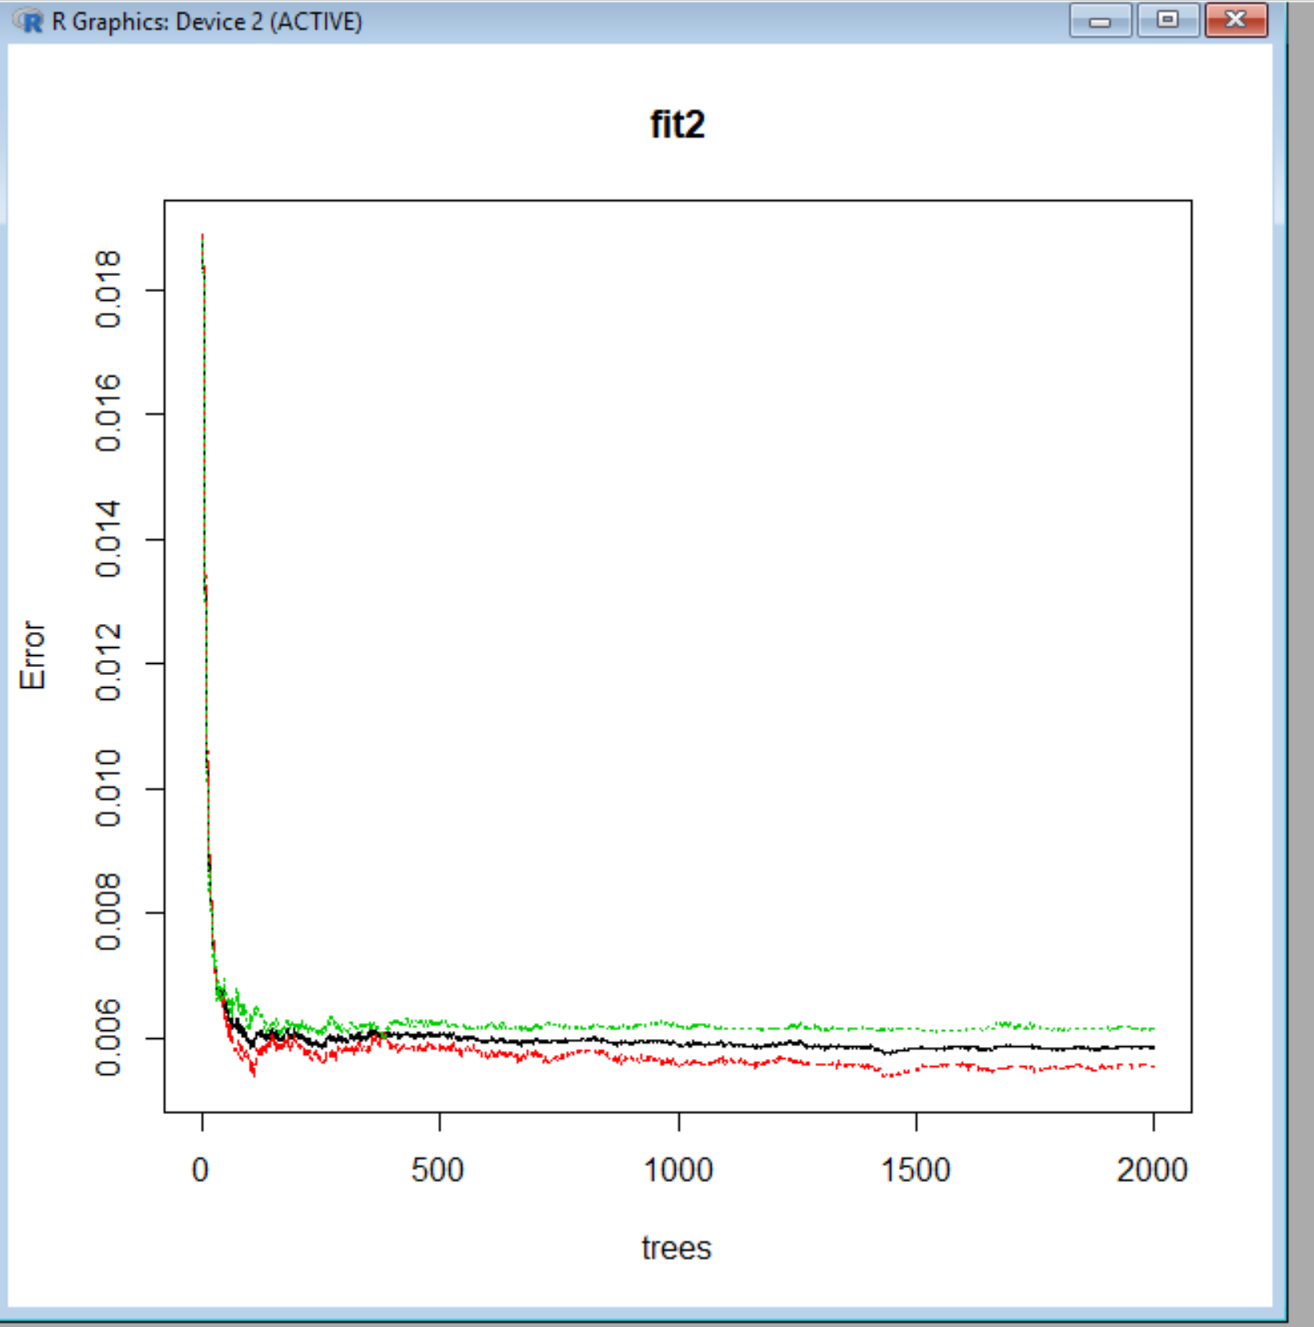
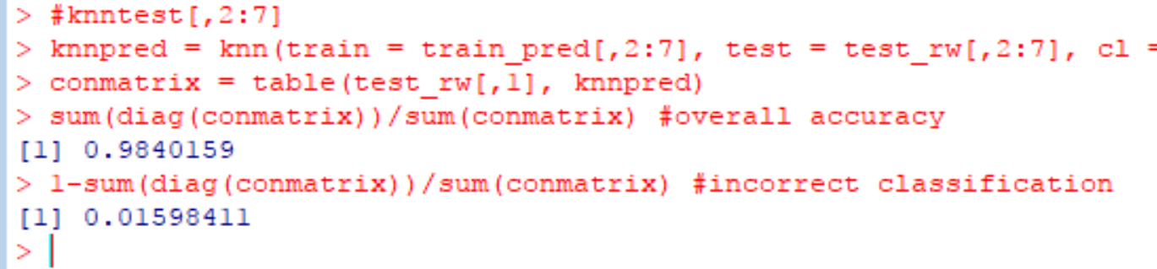
Random Forest
Random Forest is one of the most widely used machine learning algorithm for classification
It can also be used for regression model.
It is operated by constructing a multitude of decision trees at training time and outputting the class that is the mode of the classes (classification) or mean prediction (regression) of the individual trees
k-Nearest Neighbor Predictions

Slide 30


Slide 31
Evaluations Methods
Evaluation is mainly based on cut off value
Confusion matrix(Accuracy)
AIC
chi square
Hosmer and Lemeshow goodness of fit (GOF) test
Overdispersion
ROC curve and the AUC
threshold value(cut off)

Slide 32
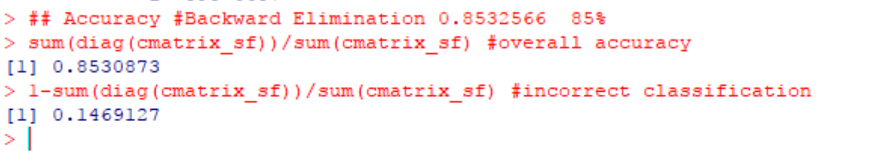

Confusion matrix(Accuracy)
step wise Forward
85%
Step wise backward selections
85%
Decision Trees
94%
Random Forest
99%
Backward Elimination
85%

Slide 33

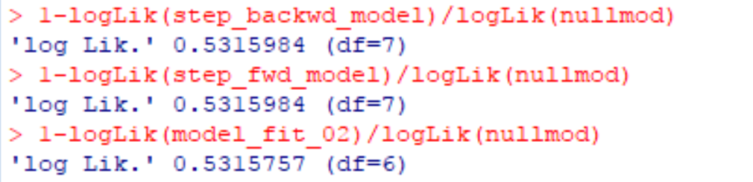

AIC & Adj R square VALUE
step wise Forward
AIC 45944
Adj Rsqar 0.5315984
Backward Elimination
AIC 45945
Adj Rsqar 0.5315757
Step wise backward selections
AIC 45944
Adj Rsqar 0.5315984
Fit

Slide 34
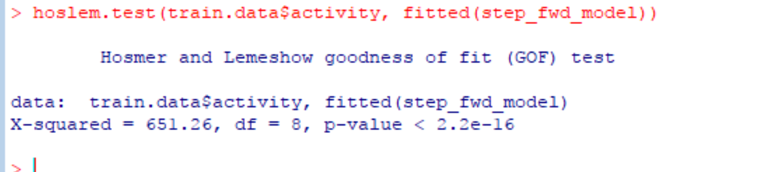

Hosmer and Lemeshow goodness of fit (GOF)
The result of the test does not confirm the model is correct as we have significant difference between the model and the observed data (i.e. the p-value is below 0.05)

Slide 35
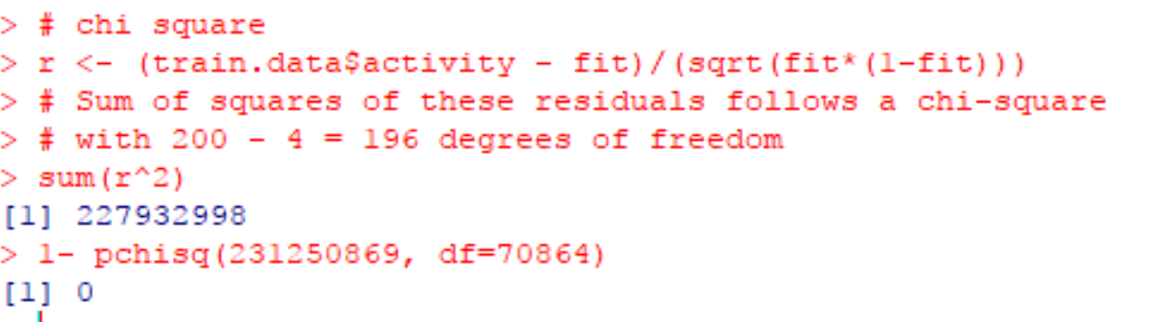

chi square
The P-Value is < 0.00001. The result is significant at p < 0.05. Null Hypothesis is true (which means there really is no difference)

Slide 36

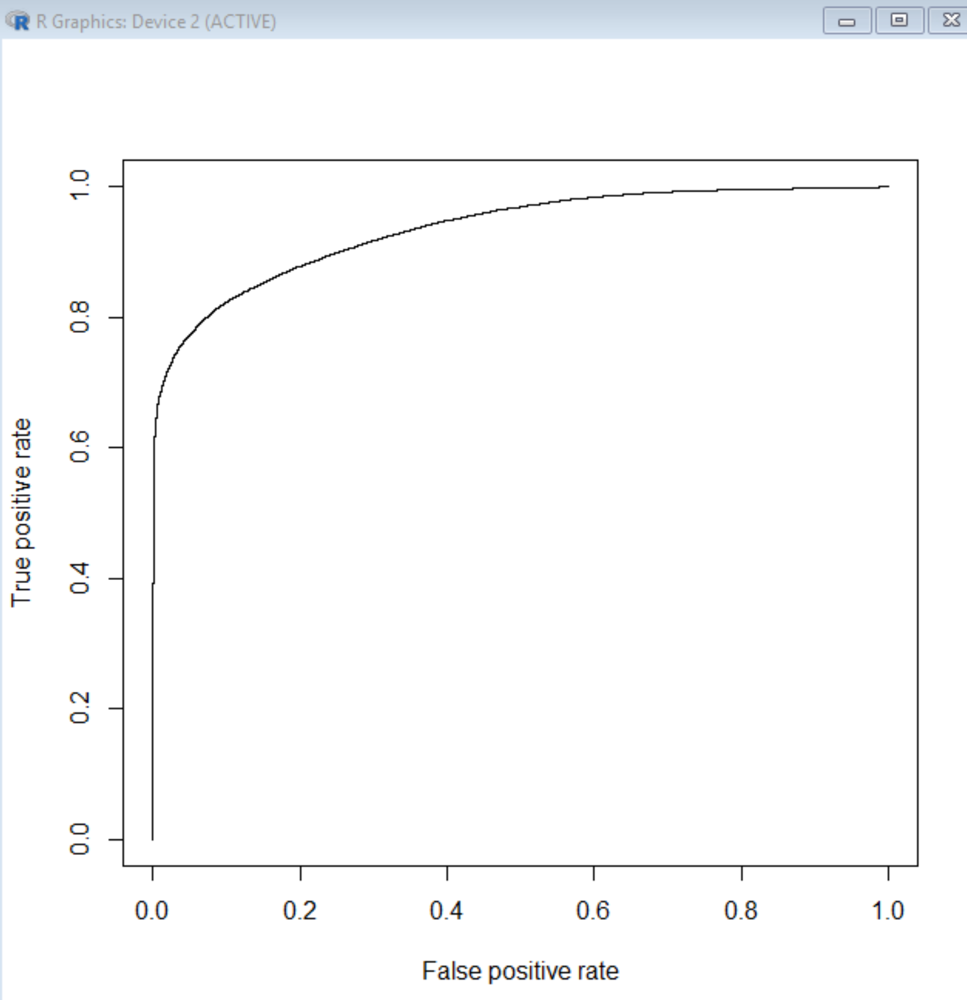
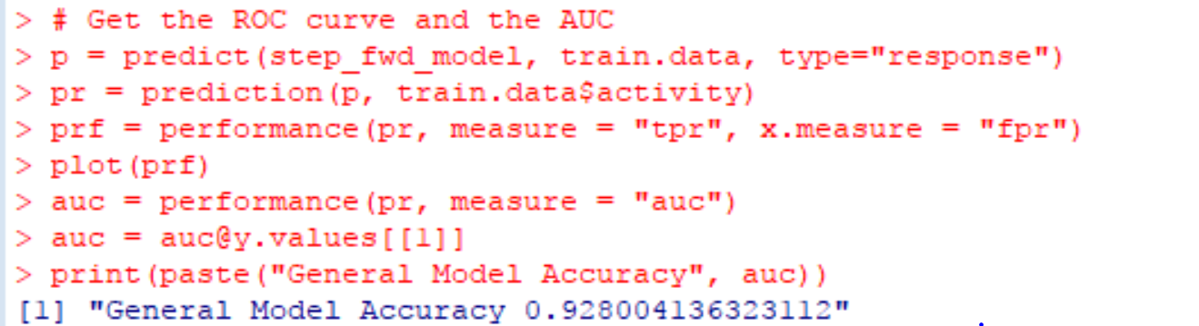
ROC curve and the AUC

Slide 37
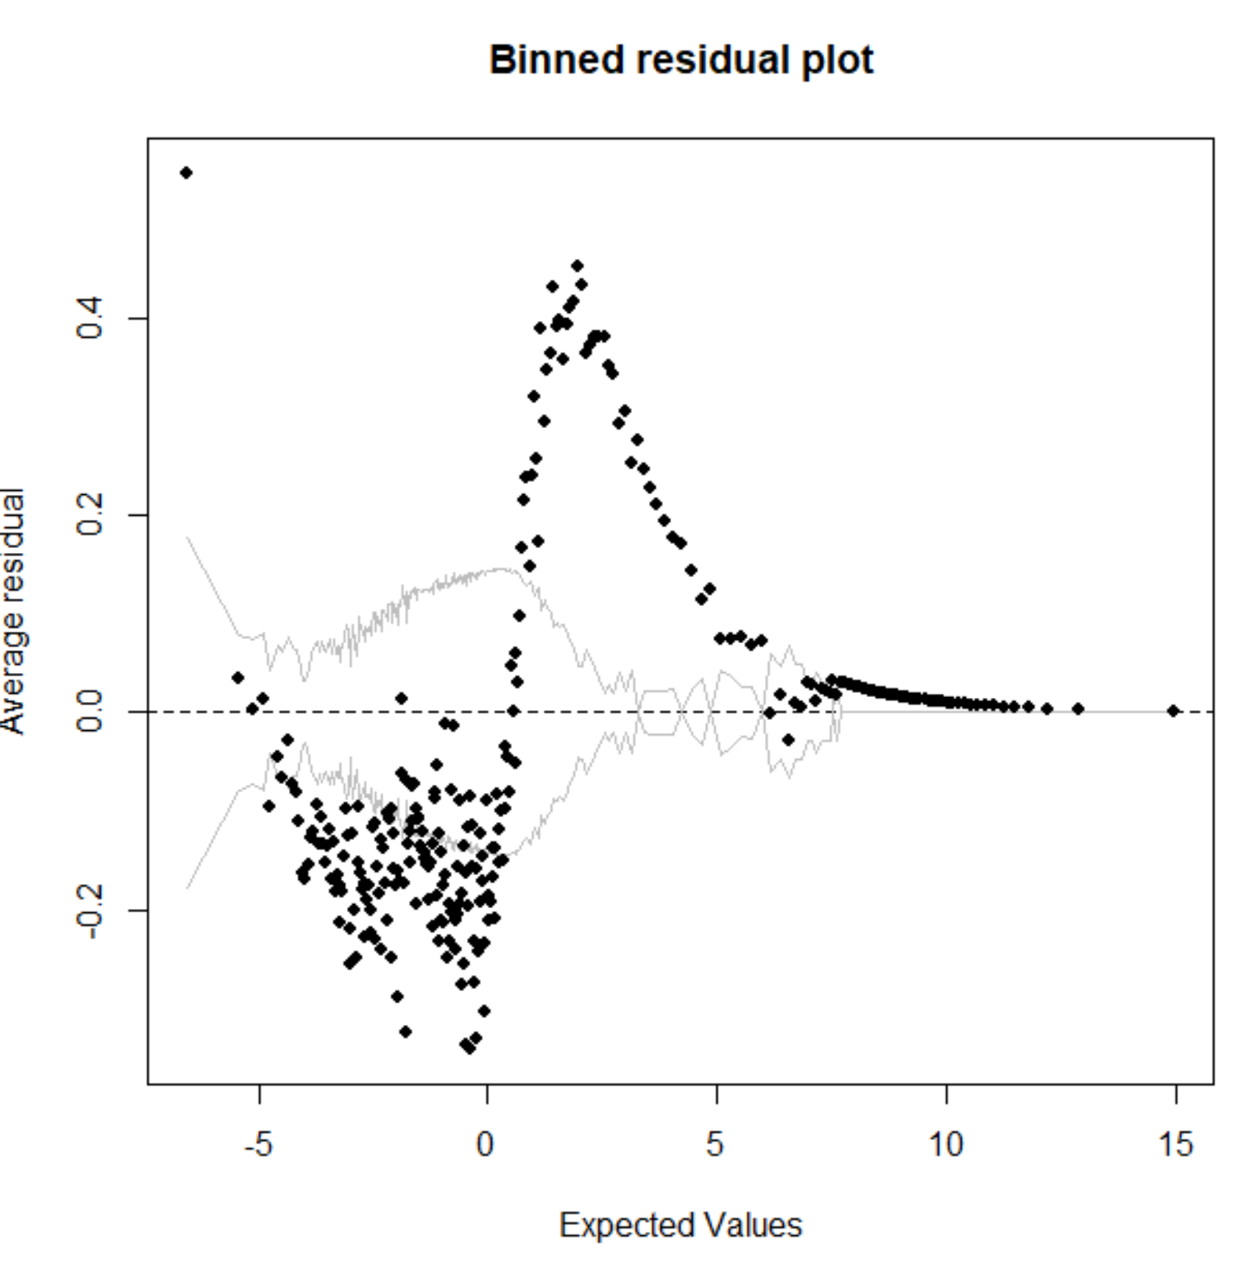
Overdispersion
Overdispersion means that the data show discrepancies between the observed responses yi and their predicted values larger than what the binomial model would predict overdispersion is present in a dataset, the estimated standard errors and test statistics the overall goodness-of-fit will be distorted

Slide 38
Conclusion

Slide 39
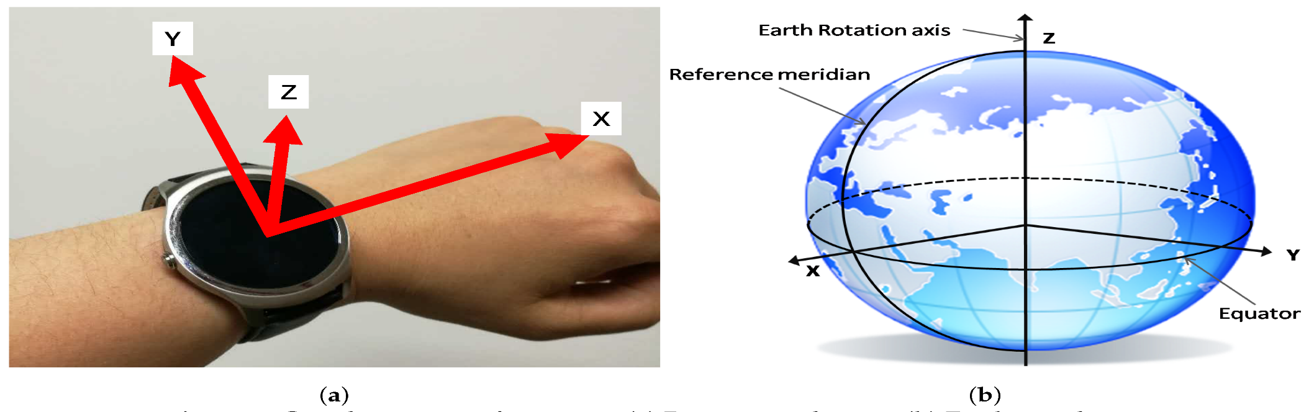
Future Work
In future, Collection and Processing of Data from Wrist Wearable Devices in Heterogeneous and Multiple-User Scenarios can be implemented based on this scenario.

